Slide 1

Operations & Customer Insights
Prepared by: Jaykant Mendapara

Slide 2
Introduction
The presentation is pertaining to the insights generated from a dataset of total 173237 records for the first half of the year 2019. Dataset contains transaction records from the available source of distribution for 44724 unique customers in the duration of January 2019 – June 2019 across 31 Provinces. Using the Dataset, Following questions were answered.
Average gross basket delivered per store partner
Average gross basket delivered per store partner considering only the customer with at least 3 order
Are customers loyal to the store partner?
How many customers switch delivery provinces?
How many customers switch sources?
Demonstrate (if true) that the average gross basket delivered increases with the number of orders for each customer

Slide 3
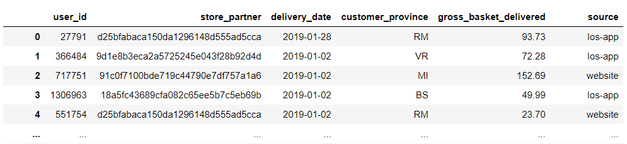
Data set
user_id | Unique identifier for a user | 44724 Users
store_partner | Unique identifier of a retailer | 16 Store Partners
delivery_date | Order delivery date | 2nd Jan 2019 – 20th June 2019
customer_province | Customer province | 31 Provinces
gross_basket_delivered | Revenue Amount generated in Euro | Avg. of 1759446 Euros transaction per month
source | Platform used to Create/Place the order | 4 Different sources

Slide 4
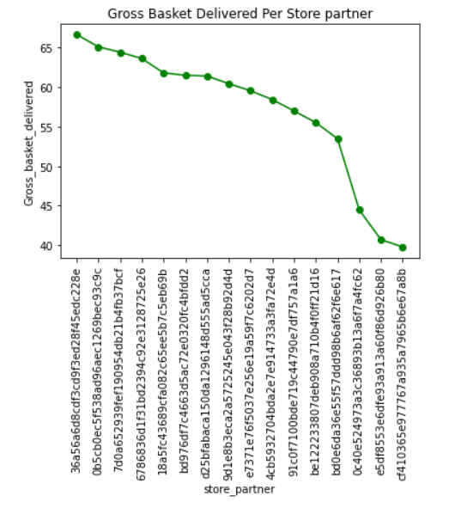
Gross Revenue Per Store Partner
Overall Average Revenue - 60.937772
sadbd0e6da36e55f57ddd98b6af62f6e617 - 53.470845
0c40e524973a3c36893b13a6f7a4fc62 - 44.453810
e5df8553e6dfe93a913a60f86d926b80 - 40.674444
cf410365e977767a935a7965b6e67a8b - 39.766578
8 Stores have a below average revenue collection.
A sudden drop between the 3rd & 4th store from the bottom with a difference of approx. ~9 Euros

Slide 5
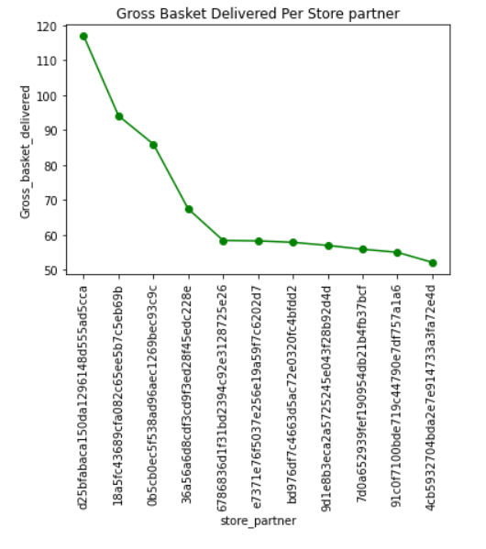
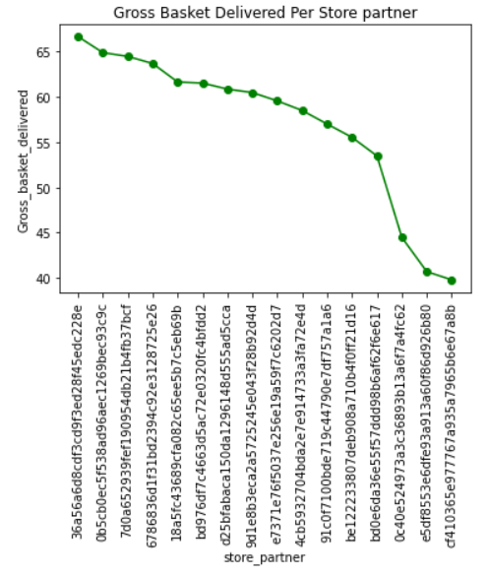
Gross Revenue Per Store Partner
For Customer with 3 or more Transaction
For Customer with just 1 or 2 Transactions

Slide 6
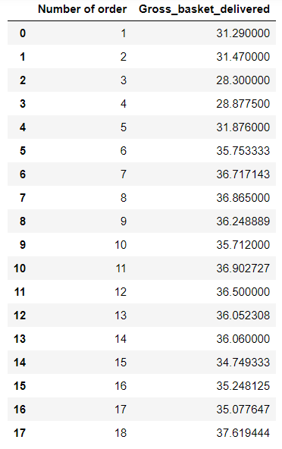

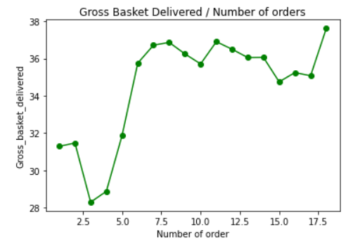
Hypothesis Testing
Steps performed to test the hypothesis :
”Average gross basket delivered increases with the number of orders for each customer”
Random Sample’s User ID - 1374598
Generate a Sample.
Extract order records for the sample user ID.
Generating Average gross basket delivered with the number of orders (incremental) for the sample customer.
Plotting the line chart for Average gross basket delivered with the number of orders for the sample customer.

Slide 7
Loyal Customers
Assumption: Loyal Customers are the Customers Who
bought Total of 3 or more products from the same store partner - 124
Bought Total of 3 or more products using the same source - 259
Did Total of 5 or more transactions in the period - 253
Minimum of 3 products and minimum transaction of 15 Euros in the period for each Transaction - 331

Slide 8


199 Customers switched Province

Slide 9


5438 Customers Switched Source

